Slide 1


Python Coding Session Data Structures
Introduction to Implementation Details and Usage

Slide 2

Introduction
Python data structures are fundamental components used to organize and store data efficiently. in Python we have : lists, tuples, sets, and dictionaries.

Slide 3
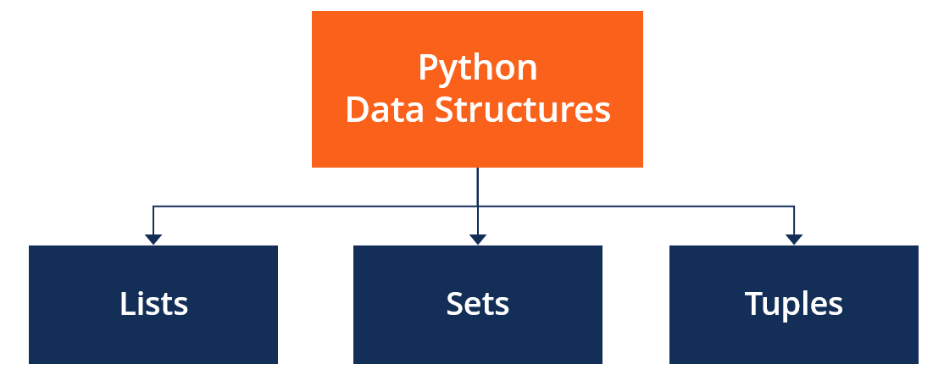
Python Built in Data Structures

Slide 4
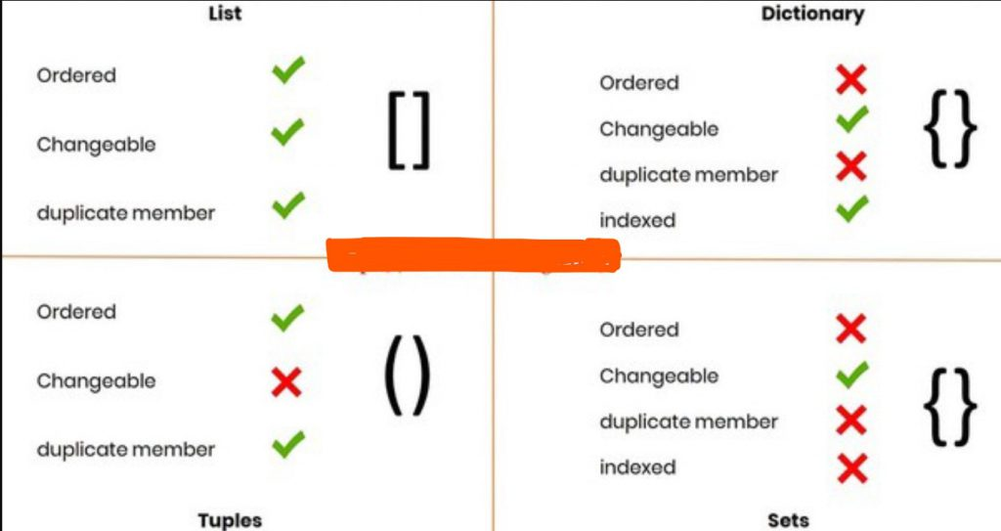
Comparing

Slide 5



Sintax

Slide 6
Pratice
Create a program that takes a list of numbers as input and calculates the sum of all the numbers in the list.
Write a program that takes a list of words as input and removes duplicates, then prints the unique words in alphabetical order.
Create a program that takes a list of students and their corresponding scores as input and converts it into a dictionary.

